Slide 1

Note: The data and information in this document is reflective of a hypothetical situation and client. This document is to be used for KPMG Virtual Internship purposes only.
Sprocket Central Pty Ltd
Data analytics approach
Dayanand Jola Dinakar

Slide 2
Note: The data and information in this document is reflective of a hypothetical situation and client. This document is to be used for KPMG Virtual Internship purposes only.
Agenda
Introduction
Data Exploration
Model Development
Interpretation

Slide 3
Note: The data and information in this document is reflective of a hypothetical situation and client. This document is to be used for KPMG Virtual Internship purposes only.
Introduction
Identify and Recommend High Value Customers
Problem outline
Sprocket Central Pty is a company that specializes in high quality bike accessories.
The Marketing team is looking to boost sales
To target 1000 new customer that will bring the highest value to the business
Approach For Data Analysis
Bike related purchases for the last 3 years based on gender
Top industries contributing the maximum profit and bike related sales
Wealth Segment by age category
Number of Cars owned in each state
Customer Classification

Slide 4
Note: The data and information in this document is reflective of a hypothetical situation and client. This document is to be used for KPMG Virtual Internship purposes only.
Data Exploration
Data Quality Assemenmt
Key issue dealt with for the data quality issue
 | Accuracy | Completeness | Consistency | Currency | Relevancy | Validity
Customer Demographic | DOB: Inaccurate Age: Missing | Job Title: Blanks Customer ID: Incomplete | Gender: Inconsistent | Deceased Customer: Filtered out | Default Column: Delete
Customer Address |  | Customer ID: incomplete | States: Inconsistent
Transactions | Profit : Missing | Customer ID: Incomplete Online Orders: Blanks Brands: Blanks |  |  | Cancelled Status Order: Filtered out | List Price: Format Product Sold Date: Format

Slide 5
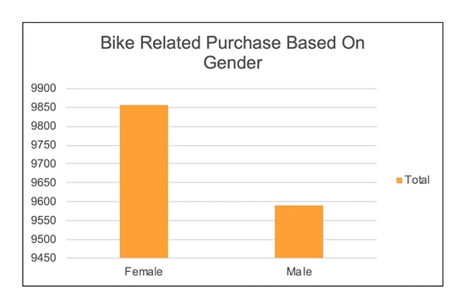
Note: The data and information in this document is reflective of a hypothetical situation and client. This document is to be used for KPMG Virtual Internship purposes only.
Model Development
Bike related purchase over the last 3 years based on Gender
Data Shows, on average females have made more bike related purchases in the last 3 years compared to males
On average females have had 1% higher bike related compared to the men in the last 3 years

Slide 6
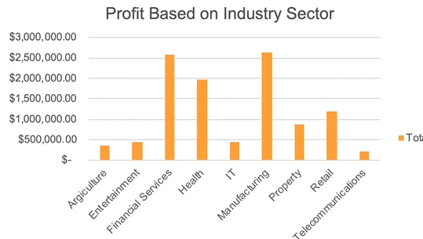
Note: The data and information in this document is reflective of a hypothetical situation and client. This document is to be used for KPMG Virtual Internship purposes only.
Interpretation
Top Job Industry Contributing to the maxing profit and bike related purchases
The top 3 industry sector bringing in the highest profit are: Financial services, Health and Manufacturing
These can be obvious as most of these industry sectors are based within the city or on the outskirts of the city therefore consumers prefer bikes for commuting
Most of the Industry Sectors have returned less than $1,000,000 in profits
Place any supporting images, graphs, data or extra text here.

Slide 7
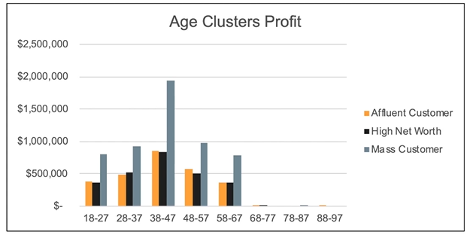
Note: The data and information in this document is reflective of a hypothetical situation and client. This document is to be used for KPMG Virtual Internship purposes only.
Interpretation
Profit of wealth segment by age cluster
Overall, the mass customer segmentation makes the highest profit across the different age clusters.
Mass customer aged between 38-47 are likely to bring more profit for the company compared to other age clusters.
This also indicates a trend of buying power, as the buying increases over time till 47 and then see’s a decline in buying power, thus leading to lower profits
Place any supporting images, graphs, data or extra text here.

Slide 8
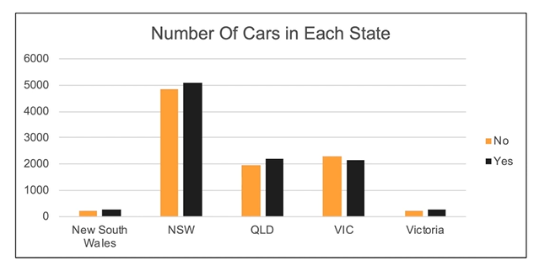
Note: The data and information in this document is reflective of a hypothetical situation and client. This document is to be used for KPMG Virtual Internship purposes only.
Interpretation
Number of Cars owned in each state
NSW, QLD and VIC could be potential market opportunities for the company
NSW, has the highest potential as the number of people that own car is almost equal to the people who don’t own cars which shows that there is opportunity to find value customers there.
Place any supporting images, graphs, data or extra text here.

Slide 9
Note: The data and information in this document is reflective of a hypothetical situation and client. This document is to be used for KPMG Virtual Internship purposes only.
Interpretation
Customer classification- Targeting High value customers
Most of the high value customers will be female compared to male
Working in the financial, Health and manufacturing industry sector
Aged between 38-47
Who are currently living in NSW and VIC

Slide 10
Note: The data and information in this document is reflective of a hypothetical situation and client. This document is to be used for KPMG Virtual Internship purposes only.
Interpretation
Customer classification- Targeting High value customers
Most of the high value customers will be female compared to male
Working in the financial, Health and manufacturing industry sector
Aged between 38-47
Who are currently living in NSW and VIC

Slide 11
Note: The data and information in this document is reflective of a hypothetical situation and client. This document is to be used for KPMG Virtual Internship purposes only.
Appendix

Slide 12
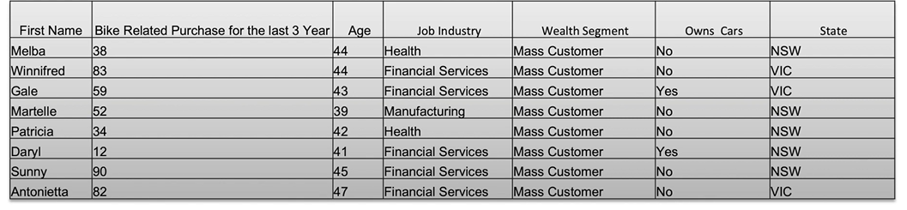
Note: The data and information in this document is reflective of a hypothetical situation and client. This document is to be used for KPMG Virtual Internship purposes only.
Appendix
Summary Table for high value customers

